Slide 1


Slide 2

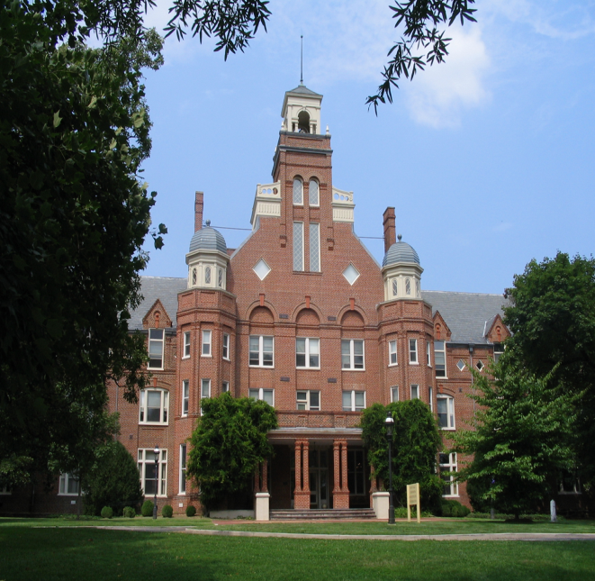






Contents
Words & Phrases
Language Points
Exercises
Extension Activities
Active Reading1

Slide 3


Warming Up
Watch the movie clip and discuss the questions
Further Discussion
How to write a diary in English

Slide 4



Warming Up
Watch the movie clip and discuss the questions:
1. What do you think of the teacher in the film?
2. What do you expect to learn in the university?

Slide 5
Warming Up
Further Discussion
Work in pairs. Look at the list of education objectives and number them in order of importance to you.
☐ finding a girlfriend / boyfriend
☐ studying hard and learning a lot
☐ meeting people and making friends
☐ getting a good job when you graduate
☐ having fun
☐ growing up and becoming independent
☐ going to parties
☐ doing lots of sport
☐ reading widely
☐ learning new skills and having new experiences

Slide 6

Warming Up
How to write a diary in English
1. Format:
a. Write down the date, the day and the weather on the first line. The date and the day are on the left, while the weather is on the right.
b. Write the body part. Write this part on the second line.
2. Person:
Write the diary in the first person.

Slide 7
Warming Up
3. Tense:
a. Past tense;
b. Present tense;
c. Future tense.
4. Order:
Write the diary in chronological order.
5. Style
Casual and informal: express a personal viewpoint with reactions, reflections and feelings.

Slide 8


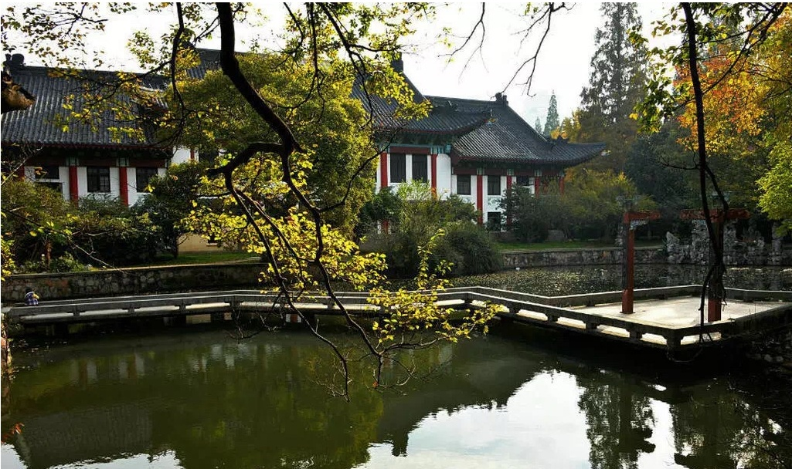
Text
Diary of a fresher

Slide 9

Text
Diary of a fresher
Sunday
1 After a wearisome expedition by car from home, we arrive at my hall of residence, and I check in. The warden gives me a set of keys and a room number. My room is five floors up, and the lift has a sign on it, “Out of order”. Finally, with my mother flushed and gasping for breath, we find Room 8, I unlock the door, and we all walk in.
2 After one minute, my father climbs out. The room is barely big enough for one, and certainly not big enough for the whole family. I can stretch out full-length on the bed and touch three walls without moving a muscle.
3 Lucky my brother and my dog didn’t come too.
4 Later. My parents have just left. I’m here alone, hemmed in by my books and a suitcase. What do I do next?

Slide 10
Text
Monday
5 There’s a coffee morning for first-year students. I meet my tutor, a lofty man with
sloping shoulders, who looks determined to be affable.
6 “Have you come far?” He peers down at me. As he speaks, his head jerks wildly
from side to side, which makes his coffee spill into the saucer.
7 “I live not far from Edinburgh, about six hours away,” I explain.
8 “Splendid!” he says, and moves on to the freshman standing beside me. “Have
you come far?” he asks, “splendid,” he barks, without waiting for the answer, and
moves on. He takes a sip of coffee, and looks thunderstruck to discover the cup is
empty.
9 My mother calls. She enquires if I’ve met my tutor yet.

Slide 11
Text
Tuesday
10 Am feeling a bit peckish, and it occurs to me that I haven’t eaten for two days. I go downstairs and stumble across the dining hall, where I can have three meals a day. I go down and join a lengthy file of people winding its way out into the open.
11 “What’s for breakfast?” I ask the guy in front of me.
12 “No idea. I was too late for breakfast. This is for lunch.”
13 It’s self-service and today’s menu includes chicken, rice, potatoes, salad, vegetables, cheese, yoghurt and fruit. The boy in front piles it all onto his plate, pays for it, and goes to sit down. I seem to have lost my appetite.
14 My mother calls. She asks if I’m eating proper meals.

Slide 12
Text
Wednesday
15 I have a lecture at 9 am. I wake up at 8.45. No one has woken me. Weird.
16 I pull on some clothes, and dash over to the lecture hall. I sit down beside a girl who looks half asleep. She inspects me. “Just got up?” she asks. How can she tell?
17 The lecture takes an hour, and at the end I look at my notes. I can’t read my handwriting.

Slide 13
Text
18 The girl’s name is Sophie and she’s an English literature major, like me. She looks frighteningly intelligent, and when we chat after the lecture, she tells me she read the whole of this term’s reading list during her gap year. She’s a bit impressive, and I feel so ignorant … I don’t even think I should breathe the same air as her.
19 Mum calls. She asks if I slept OK.

Slide 14
Text
Thursday
20 It’s the Freshers’ Fair today, and Sophie and I go along to see how many clubs we can join. We concur that we want to make a lot of friends, so I sign up for ballroom dancing, the Artificial Intelligence Society, bell ringing and the Extreme Sports Club. Sophie signs up for Amateur Dramatics and the Mozart choir. I wonder if Sophie and I are going to stay buddies.
21 Mum calls. My brother has tried to rent out my bedroom back home. Mum reassures me that it’s mine for as long as I need it, that it’s my home and that they miss me very much, especially the dog. I burst into tears.

Slide 15
Text
Friday
22 In the morning, I go to the library. But it seems I need some form of identification. But I don’t have an ID card yet. For some reason, I also have to swear that I won’t damage the books or break the library rules, and if I do, I’ll be sent to prison. (What!? For speaking too loudly?) It seems that it’s a very old library, and the university is inordinately proud of it.
23 Tonight is Club Night at the Students’ Union, but I’ve run out of clean clothes. I’m not sure what happens to my dirty clothes after putting them in the clothes basket and before finding them clean, ironed and folded in my wardrobe. Maybe Mum will call soon.
■

Slide 16

Text
大一新生日记
星期日
1 从家里驱车经过一段疲惫的旅程才到达我住的宿舍楼。我进去登记。宿舍管理员给了我一串钥匙，并告诉了我房间号。我的房间在6楼，可电梯上写着“电梯已坏”。等我们终于找到8 号房间的时候，妈妈已经涨红了脸，累得上气不接下气。我打开房门，我们都走了进去。
2 但爸爸马上就从里面爬了出来。这个房间刚刚够一个人住，一家人都进去，肯定容不下。我躺在床上，把全身伸直，不动弹就可以碰到三面墙。
3 幸亏我哥哥和我的狗没一起来。
4 后来，爸爸妈妈就走了，只剩下我孤零零一个人，周围只有书和一个箱子。接下来我该做什么呢？

Slide 17
Text
星期一
5 早上，有一个为一年级新生举办的咖啡早茶会。我见到了我的 导师，他个子高高的，斜肩，好像打定了主意要平易近人。
6 “你是从很远的地方来的吗？”他居高临下地看着我问道。他边说话边晃动脑袋，咖啡都洒到杯托里了。
7 “我家离爱丁堡不太远，开车大约6个小时，”我说。
8 “好极了！”他说，接着又转向站在我旁边的那个新生。“你是从很远的地方来的吗？”他问。但不等那人做出任何回答，他就说道，“好极了！”然后就继续询问他人。他啜了一口咖啡，却惊讶地发现杯子是空的。
9 妈妈打来电话，问我是不是见到了导师。

Slide 18
Text
星期二
10 我觉得有点儿饿，这才意识到我已经两天没吃东西了。我下楼去，踉踉跄跄地到了餐厅，得知一日三餐可以在餐厅里吃。我走下去排队，那队伍像一条长龙弯弯曲曲一直排到了门外。
11“早餐吃什么？”我问前面的男生。
12“不知道。我来得太晚，没赶上早饭。这是午饭。”
13 午饭是自助餐，今天的饭有鸡肉、米饭、土豆、沙拉、蔬菜、奶酪、酸奶和水果。前面的男生每样儿都取了一些放到托盘上，付了钱，坐下来吃。而我好像已经没胃口了。
14 妈妈打来电话，问我有没有好好吃饭。

Slide 19
Text
星期三
15 我早上 9 点钟有个讲座。我醒时已经 8:45 了。竟然没有人叫我起床。奇怪。
16 我穿好衣服，急匆匆地跑到大讲堂。我在一个睡眼惺忪的女生旁边坐下。她打量我一下，问：“刚起床？”她是怎么看出来的？
17 讲座持续了1个小时。结束时我看了看笔记，我根本就看不清我写了些什么。

Slide 20
Text
18 那名女生名叫苏菲，和我一样，也是英语文学专业的学生。她看起来惊人地聪明。听完讲座后我们一起闲聊。她告诉我在间隔年里，她已经把这学期书单上的书全都读完了。她令人钦佩，我觉得自己太无知了，我甚至不配跟她呼吸同样的空气。
19 妈妈打来电话，问我睡得好不好。

Slide 21
Text
星期四
20 今天有新生集会。我和苏菲跑去看我们能加入多少个俱乐部。我们俩都认为我们应该多结交朋友，所以我报名参加了交谊舞俱乐部、人工智能协会、手铃俱乐部和极限运动俱乐部。苏菲则报名参加了业余剧社和莫扎特合唱团。我不知道苏菲和我还能不能继续做好朋友。
21 妈妈来电话了。她告诉我哥哥曾试图把家里我的卧室租出去。妈妈向我保证只要我需要，那永远是我的房间。她还说那是我的家，他们都非常想我，尤其是我的狗。我忍不住泪流满面。

Slide 22
Text
星期五
22 早上我去了图书馆。可是好像我需要一个能证明我身份的证件才能进图书馆。可我现在还没有。出于某种原因，我还得发誓不会损坏书籍、不会违反图书馆的规定，否则我就要进监狱。（什么！？ 就因为大声说话吗？）图书馆看上去很古老，学校为此感到特别自豪。
23 今晚学生会举办“社团之夜”晚会，可我已经没有干净衣服穿了。我可不清楚把脏衣服扔进脏衣篮之后到它们干干净净、熨烫笔挺并叠好放进衣柜之前都发生了什么。也许妈妈快来电话了。

Slide 23

Words & Phrases
fresher
stretch
spill
wearisome
full-length
sip
expedition
muscle
thunderstruck
residence
hem
enquire
warden
lofty
peckish
sign
slope
stumble
flush
affable
lengthy
gasp
peer
guy
unlock
jerk
weird
barely
wildly
frighteningly

Slide 24
Words & Phrases
intelligent
concur
buddy
gap
ballroom
reassure
impressive
dramatics
inordinately
ignorant
choir
wardrobe
check in
rent out
out of order
as long as
stretch out
burst into tears / song / laughter
go along
run out of
sign up for

Slide 25
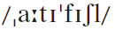
Words & Phrases
Edinburgh 爱丁堡（苏格兰首府）
Artificial Intelligence Society 人工智能协会
Extreme Sports Club 极限运动俱乐部
Mozart 莫扎特
ID card (identity card) 身份证

Slide 26
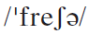
Words & Phrases
fresher n. [C] (AmE freshman) a student in their first year at university 大学一年级学生
e.g.
1. Being a fresher / freshman there was the academic equivalent of boot camp.
在那里上大学一年级就等于是进了新兵训练营。
2. The fresher / freshman took a while to orient himself.
那位大学新生花了一段时间才熟悉了环境。
See more expressions about American and British English.

Slide 27
Words & Phrases
American and British English
Year of study | British Expression | American Expression
First year
Second year
Third year
Fourth year
first-year student / fresher (in first months of study)
freshman
second-year student
sophomore
third-year student / final-year student (of a three-year program)
junior
fourth-year student / final-year student (of a four-year program)
senior

Slide 28
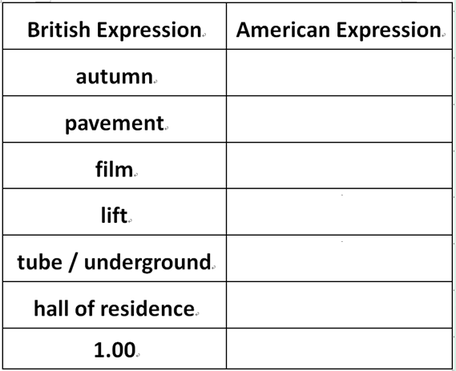

Words & Phrases
American and British English
fall
sidewalk
movie
elevator
subway
dormitory
1:00

Slide 29
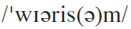
Words & Phrases
wearisome a. a wearisome activity or time is one that makes you feel tired or bored 使人疲倦的；令人厌倦的
e.g.
1. If, however, the study of phonetics is too wearisome for you, you can do without it.
如果你感到学习语音太枯燥，也可以不学。
2. Walking in the burning sunshine makes people wearisome.
在灸热的阳光下行走让人感到疲倦。
Word family: weary v. & a.
- some a. 表示“引起……的”。
e.g. troublesome bothersome burdensome
麻烦的 麻烦的 繁重的

Slide 30
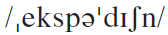
Words & Phrases
expedition n. [C]
a short journey somewhere, especially for pleasure
（尤指休闲性质的短程）旅行，出行
e.g. In a short time he was sufficiently recovered to undergo the fatigue of this expedition.
不久，他的健康已经恢复到禁得起这样一番旅途的劳顿。
2. a long journey organized for a particular purpose, especially to a dangerous or distant place 探险；考察
e.g. He learned a lot during his scientific expedition last year.
他去年科学考察期间学到了不少东西。

Slide 31
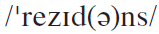
Words & Phrases
residence
1. n. [C] (fml) a house or other place where sb. lives, especially a large house used by an important person 住所；住宅；官邸；公馆
e.g.
1. The Elysee Palace serves as the combined residence and office of the French head of state.
爱丽舍宫既是法国总统的官邸又是他的办公处。
2. No 10 (Downing Street) is the official residence of the British Prime Minister.
（唐宁街）10号是英国首相府。
2. n. [U] the fact that sb. lives somewhere, or the period of time that they spend living there 居住；居留期间
e.g. They took up residence abroad.
他们定居了国外。

Slide 32
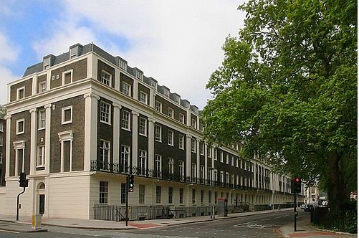
Words & Phrases
a hall of residence
A hall of residence (AmE dormitory) is a place where students live, often a large building or a series of buildings with accommodation and some social facilities. Food may be provided or the hall may be self-catering (students arrange their own meals and cook for themselves).

Slide 33
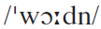
Words & Phrases
warden n. [C]
1. sb. whose job is to be responsible for a particular place or thing, and who checks that rules are obeyed 看守人； 监管人；管理人
e.g. He wants to be a warden of the local nature reserve after graduation.
他希望自己毕业后成为当地自然保护区的看守人。
A warden is an adult who looks after the buildings and facilities in a hall of residence. A warden may also be an academic teacher. He or she may be assisted by sub-wardens, who are generally postgraduate students (they receive some payment and free / cheap accommodation).

Slide 34

Words & Phrases
2. (AmE) a governor of a prison 典狱长；监狱长
e.g. He is a warden who keeps order by hectoring his prisoners.
他是个靠吓唬犯人来维持秩序的监狱长。

Slide 35
Words & Phrases
sign
1. n. [C] a flat object with words or pictures on it, put in a public place to provide information or advertise sth. 招牌；广告牌
e.g.
1. The sign by the road said “No Parking”.
路边的告示牌上写着“禁止停车”。
2. The welcome sign is up.
欢迎的牌子已经竖起来了。
2. n.[C, U] a piece of evidence that sth. is happening or that sth. exists 迹象；标志
e.g.
1. A cloudy sky is not always a sign of rain.
2. Agitated activity by certain animals may be a sign of an impending earthquake.
某些动物烦躁不安可能是地震临震前的预兆。
阴天未必有雨。

Slide 36
Words & Phrases
3. v. write your name on sth. in your own personal way 签字（于）；签名（于）
e.g.
1. Please sign your name on the bottom line if you want to cash the check.
你如果想兑支票，请在底线上签名。
2. He signed his name in the presence of two witnesses.
他当着两个证人的面签上了自己的名字。
See also: sign up for

Slide 37
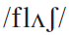
Words & Phrases
flush vi. if sb. flushes, their face becomes red because they are hot or ill, or feeling angry, embarrassed, or excited 脸红
e.g.
1. Mark flushed with annoyance, but said nothing.
马克气得满脸通红，不过没说什么。
2. His face flushed with embarrassment.
他因窘迫不安而红了脸。
3. Do you flush after drinking a glass of beer?
你喝了一杯啤酒后会不会脸红?

Slide 38
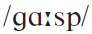
Words & Phrases
gasp vi. (mainly literary) make a violent effort to breathe because you need more air 急促地喘气；猛地吸气
e.g.
1. The wounded soldier gasped out a few words.
那个受伤的士兵上气不接下气地说了几句话。
2. After running such a long way, the police dog was gasping for breath.
警犬在跑了这么长一段路后，直喘粗气。
3. It was so hot a noon that the leaves had to gasp for breath.
那天中午，天气热得连树上的叶子也在喘气。

Slide 39
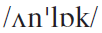
Words & Phrases
unlock vt. open the lock on sth. such as a door or a window, usually with a key （通常用钥匙）打开（门或窗的锁）
un + v. → v. 表示“做相反的动作”
e.g.
1. Would you please unlock the door for me?
打开（门锁）
2. What’s done cannot be undone.
未做的
3. The customs officer had all the bags unpacked but found nothing suspicious in them.
解开；打开

Slide 40
Words & Phrases
4. The pain in his hands made it difficult to undo his clothing.
松开；解开
5. Laura opened the envelope, unfolded the letter and began to read it carefully.
展开；解开
6. If only I could unsay those tactless words of mine!
取消；收回
7. The nurse undressed the baby and put it in the cradle.
脱掉……的衣服

Slide 41
Words & Phrases
barely ad. used for saying that sth. almost does not happen or exist, or is almost not possible 几乎不；几乎没有
e.g.
1. Professor White’s presentation seemed to go on forever. I was barely able to stay awake. (CET4-2000-01)
怀特教授的陈述似乎没完没了。我几乎无法让自己保持清醒。
2. He could barely keep body and soul together, let alone support his family.
他连自己的生活都难以维持，更不用说养家了。
3. The road was barely wide enough for two cars to pass.
这条路几乎不够两辆车通行。

Slide 42
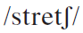
Words & Phrases
stretch
1. v. make your arms, legs, or body as straight as possible so that your muscles become long and tight 伸展肢体；伸懒腰
e.g.
1. I leaned back in the chair and stretched.
我身体往后靠在椅子上，伸了个懒腰。
2. He stretched himself with a yawn.
他一边打着呵欠一边伸了伸懒腰。
3. David took a seat on the aisle stretching out his long legs.
戴维在走道边找了一个座位坐下，舒展开他那两条长腿。

Slide 43
Words & Phrases
2. n. a movement or exercise in which you make a part of your body as straight as possible so that your muscles become long and tight （肢体）伸展；伸懒腰
e.g.
1. He had a good stretch on the bed.
他在床上痛快地伸了个懒腰。
2. He entered the room with a stretch and a yawn.
他伸着懒腰打着呵欠进了房间。
3. First, let’s do some warm-up stretches.
我们先做一些热身的伸展运动。
See also: stretch out

Slide 44
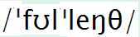
Words & Phrases
full-length
1. ad. If you are lying full-length, you are lying down with your legs stretched out 平躺地；双腿伸直地
e.g. The boy went into his bedroom and stretched out full-length on the bed.
2. a. a full-length coat, dress, or skirt goes down to your feet; a full- length mirror or picture shows someone’s whole body including their feet; a full-length book, film etc. is the normal length, not shorter 全身的；全长的；未删节的
e.g.
1. It is a full-length animation film.
这是一部没有进行过任何删节的动画片。
2. She was wearing a full-length skirt which swept the ground.
她一袭曳地长裙。
男孩走进卧室，平躺在床上。

Slide 45
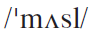
Words & Phrases
muscle n. [C, U] a piece of flesh that connects one bone to anther and is used for moving a particular part of your body 肌肉
e.g.
1. Regular exercise will help to strengthen your muscles.
经常锻炼有助于增强肌肉。
2. Beckham has pulled a muscle in his thigh and won’t play tomorrow.
贝克汉姆大腿肌肉拉伤，明天不能参赛了。
3. He strained his muscle in the match.
他在那次比赛中拉伤了肌肉。

Slide 46
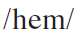
Words & Phrases
hem
1. v. (~ in) enclose sb. or sth. and prevent them from moving or leaving 围住；堵住
e.g.
1. The yard is hemmed in by leafy trees.
院子四周围长着枝繁叶茂的树木。
2. They were hemmed in by the enemies.
他们被敌人包围了。
3. He lived in a valley hemmed in by mountains.
他住在一个四面环山的山谷里。

Slide 47
Words & Phrases
2. v. fold the edge of a piece of cloth and sew it in place （给……）镶边
e.g. She hemmed her skirt with lace.
她在裙摆上镶了一道花边。
3. n. [C] the bottom edge of sth. such as a dress or curtain that is folded and sewn in place（裙子、窗帘等的）下摆，褶边
e.g. The tailor ripped the hem and shortened the dress.
裁缝拆开下摆将连衣裙改短。

Slide 48
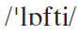
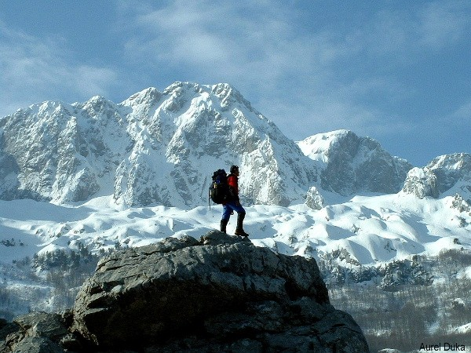
Words & Phrases
lofty a. (mainly literary)
1. a lofty building or structure is very tall （楼房等建筑物）高耸的，巍峨的
e.g. The Alps mountains, lofty and rugged, stood like an impassable wall before him.
巍峨崎岖的阿尔卑斯山，像一座无法越过的高墙屹立在他 面前。

Slide 49
Words & Phrases
2. lofty aims or principles deserve to be admired because they are based on high moral standards（理想或原则）崇高的，高尚的
e.g.
1. You should have a lofty ideal of life.
你应该有崇高的人生理想。
2. He was known to be a young man with lofty ideals.
大家都知道他是一个有抱负的青年。

Slide 50
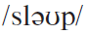
Words & Phrases
slope vi. not be completely upright 歪斜
e.g.
1. The roof of a house should be sloped in case of heavy rain.
为防大雨，屋顶必须有坡度。
2. The roof of the house sloped steeply, so the man who was doing the repairs couldn't get much of a footing on it.
屋顶很陡，那个修屋的人不容易在上面站住脚。
3. Sloping lettering is called italics.
倾斜书写的文字称作斜体字。

Slide 51
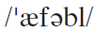
Words & Phrases
affable a. friendly, relaxed, and easy to talk to 友善的；随和的；容易交谈的
e.g.
1. It's easy to put yourself in contact with him because he is an affable person and well known there.
你能很容易跟他联系上的，他随和而且在那里很有名气。
2. She is affable enough when she is not preoccupied with business problems.
她不忙公务的时候还是很随和的。
3. His affable style and dedication to his work have won him popularity among the students.
他态度和蔼，对工作投入，在学生中很受欢迎。
Word family: affability n.

Slide 52
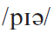
Words & Phrases
peer vi. look very carefully, especially because sth. is difficult to see 仔细看；（尤指）费力地看
e.g.
1. The stranger peered with curiosity through the railing into the courtyard.
那个陌生人好奇地透过栅栏向庭院里窥视。
2. This is one of the many recent books that seek to peer into the post-American era.
新近出现了许多这类试图窥看后美国时代的书，本书就是其中之一。
3. He stopped suddenly, stepped to the open front door and peered out.
他突然住口，蹑手蹑脚地走到开着的门口朝外窥望。
4. He peered at the tag to read the price.
他细看标签以辨认价格。

Slide 53
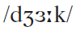
Words & Phrases
jerk
1. v. move very suddenly, or make sth. move suddenly 急推；急扭；（使）猝然一动
e.g.
1. He jerked his head towards the window.
他猛然把头扭向窗子。
2. The man jerked out a gun and pointed at me.
那人拔出一把枪对着我。
3. He jerked the string and the puppet jumped.
他猛地一拉绳子，木偶就跳了起来。
2. n. [C] a quick sudden movement; a strong sudden pull（突然的）拉/推
e.g. The knife was stuck but she pulled it out with a jerk.
那把刀子被卡住了，她猛地一拔，把它拔了出来。

Slide 54
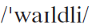
Words & Phrases
wildly ad. in an uncontrolled way 失控地；狂热地；剧烈地
e.g.
1. When the result was declared the great crowd outside the Town Hall cheered wildly.
当选举结果揭晓时，市镇厅外人山人海，大家疯狂地欢呼。
2. He felt his heart beating wildly.
他觉得他的心在猛跳。
Word family: wild a.

Slide 55
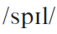
Words & Phrases
spill – spilt or spilled
1. v. if you spill a liquid, or if it spills, it accidentally flows over the edge of a container（使）溢出；（使）泼洒；（使）溅出
2. vi. if people spill out of a place, a lot of them leave at the same time 蜂拥而出
3. v. (infml) reveal (confidential information) to sb. 向（某人）说出秘密

Slide 56
Words & Phrases
Work in pairs. Figure out the meanings of the word spill. Match its usage with the meaning 1（使）溢出；（使）洒出, 2蜂拥而出or 3 向（某人）说出秘密.
1. I listened quietly as she spilled out all her private
thoughts.
2. Crowds of football fans spilled onto the field at the end
of the game.
3. There is no point (in) crying over the spilled milk.
4. He slipped and the wine spilt/spilled over the floor.
5. Oh, no! You’ve spilt/spilled coffee all down my skirt.
3
2
1
1
1

Slide 57
Words & Phrases
sip
1. n. [C] a small amount of liquid taken into your mouth 一小口
e.g.
1. Elizabeth took a sip of the hot coffee.
伊丽莎白喝了一小口热咖啡。
2. The boy took one sip of the wine and spat it out.
那男孩子呷了一小口酒，但马上又吐了出来。
2. v. drink in small amounts 小口地喝；抿
e.g.
1. She sat in the warm sun, idly sipping champagne.
她坐在温暖的阳光下，悠闲地品着香槟酒。
2. He paused to take a sip of water, and then went on.
他停下来喝了一小口水，然后又接着讲。

Slide 58
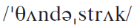
Words & Phrases
thunderstruck a. very surprised or shocked 非常吃惊的；极其震惊的
e.g.
1. I was thunderstruck to find out he had been lying the whole time.
发现她一直在说谎，我非常震惊。
2. I was thunderstruck when they told me the news.
当他们告诉我这一消息时，我惊呆了。
3. When her wandering eyes rested on the picture of a young man, she stood up, looking thunderstruck.
当她移动的视线停留在一个青年人的照片上时，她站起身来， 仿佛遭到雷击一般震惊。

Slide 59
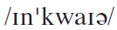
Words & Phrases
enquire v. (AmE inquire) ask sb. for information about sth. 询问；打听
e.g.
1. She wrote to enquire the cause of the delay to deliver the washing-machine.
她写信去询问推迟派送洗衣机的理由。
2. I must enquire further into this matter.
我要进一步调查此事。
Word family: enquiry n.

Slide 60
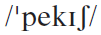
Words & Phrases
peckish a. (infml) slightly hungry 有点饿的
e.g.
1. I am a bit peckish, especially as I didn’t have anything for breakfast.
我有点饿了，尤其是因为我没有吃早餐。
2. Walking in the open air for almost two hours made him feel a bit peckish.
在户外走了几乎两个小时，他觉得肚子有点饿了。

Slide 61
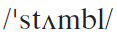
Words & Phrases
stumble vi.
1. (~ along / across / into etc.) move with difficulty and nearly fall because you are tired or ill （由于疲倦或生病而）跌跌撞撞地走，蹒跚而行
e.g. The old lady rose from the bed and stumbled over to the door.
老太太从床上起来，蹒跚地走到门口。
2. fall or almost fall while you are walking or running
绊倒；绊了一下
e.g. I stumbled over a stone and fell.
我在石头上绊了一下跌倒了。

Slide 62
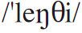
Words & Phrases
lengthy a. long, often lasting for longer than you want or expect 长的；过长的；冗长的
e.g. After several lengthy discussions they decided to accept our offer.
经过多次长时间的讨论，他们决定接受我们开的价。
Word family: length n.
e.g. Size of pension depends on length of service with the company.
养老金的多少取决于为公司服务年限的长短。

Slide 63
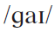
Words & Phrases
guy n.[C] (infml) a man 人；男人；家伙
e.g.
1. You guys want some coffee?.
你们诸位要咖啡吗？
2. She’s going out with some French guy she met on holiday.
她要和她在假期遇见的某个法国人去约会。
3. He is not a good guy. You’d better brush him off.
此人并非好人，你最好别理他。

Slide 64
Words & Phrases
weird a. strange and unusual, sometimes in a way that upsets you 奇怪的；古怪的；不寻常的
e.g.
1. Mike’s father got a really weird sense of humour.
迈克的父亲有一种很怪异的幽默感。
2. Tom’s full of weird and wonderful ideas.
汤姆满脑子古灵精怪的念头。

Slide 65
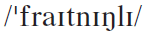
Words & Phrases
frighteningly ad.
1. (infml) used for emphasizing sth.（用于强调）非常，极其
e.g. The film was frighteningly realistic.
这部影片极其现实。
2. in a way that makes you feel afraid or nervous 令人恐惧地；令人不安地
e.g.
1. The tiger snarled frighteningly.
老虎发出可怕的吼声。
2. His eyes were frighteningly red.
他的眼睛红得可怕。
Word family: frightening a.

Slide 66
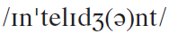
Words & Phrases
intelligent a. good at thinking clearly and quickly, at understanding difficult ideas and subjects, and at gaining and using knowledge 有智慧的；悟性高的；聪明的
Word family:
intelligently ad. intelligence n.
e.g.
1. A person who quickly learns and understands has good
intelligence.
2. Is there, somewhere out in space, intelligent life trying to speak to us?
智力；理解力
有智力的；聪明的

Slide 67
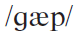
Words & Phrases
gap n. [C]
1. a period of time in which sth. does not happen 间隔；间断
2. a space or opening in the middle of sth. or between things 缺口；裂口；缝隙；裂缝
3. a difference, especially an undesirable one, between two views or situations 差距
Work in pairs and translate the following into Chinese.
2) bridge the gap between the poor and the rich (CET4-2005-06)
3) a generation gap
1) peep through the gap in the curtains
缩小贫富差距
代沟
透过窗帘上的缝隙窥视

Slide 68
Words & Phrases
gap year 间隔年
Students sometimes take a gap year after leaving school and before going to university to widen their experience and, generally, to earn money. Some students choose a temporary job in a field related to what they intend to study (this helps their studies and improves their prospects for employment later). Other students travel around their country or to other countries to find out more about other cultures, learn another language, and gain experience of different aspects of life.

Slide 69
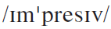
Words & Phrases
impressive a. if sth. is impressive, you admire it, for example because it is very good, large, or shows great skill 令人钦佩的；令人印象深刻的
e.g.
1. It was an impressive list of achievements.
那是份给人印象深刻的成绩单。
2. His collection of paintings is the most impressive.
他的绘画收藏令人叹为观止。
Word family: impress v.
impression n.

Slide 70
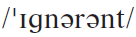
Words & Phrases
ignorant adj. (~ of) not knowing sth. that you should know or need to know 无知的；愚昧的；无学识的
e.g.
1. There are many examples of mistranslations or inappropriate translations because the translators were ignorant of the cultural differences between languages.
很多时候，翻译者因不熟悉语言之间的文化差异而做出错误 或不妥的翻译。
2. Being ignorant of the law is not accepted as an excuse for breaking the law. (CET4-2005-12)
对法律的无知并不能视作违法的借口。
Word family: ignorance n. ignore v.

Slide 71
Words & Phrases
concur vi. (fml) agree with sb. or sth. 同意；赞同
e.g.
1. I concur absolutely with your decision.
我完全同意您的决定。
2. I wonder if you will concur with the idea that money does not mean happiness
不知您是否同意金钱并不是幸福。
3. The brothers rarely concur on any issues.
他们兄弟在任何问题上都很少有一致的意见。
Word family: concurrence n.

Slide 72
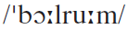
Words & Phrases
ballroom n. [C] a very large room used for dancing on formal occasions 大舞厅；舞场
e.g.
1. Dancers wheeled gracefully on the ballroom floor.
舞蹈者在舞厅的地板上优雅地旋转。
2. At eight o’clock the ballroom was a blaze of light and guests had begun to assemble.
8点钟，舞会厅正灯火辉煌，客人们已开始聚集。
See more about: ballroom dancing 交谊舞；交际舞

Slide 73
Words & Phrases
Ballroom dancing is a type of dancing done by a man and a woman together, often in a room where formal balls, or dances, take place.
Ballroom dances include the waltz, the foxtrot and the tango.
Of course, there are other dances. Let’s watch…

Slide 74
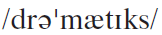
Words & Phrases
dramatics n. [U] the activity of performing plays 戏剧表演
e.g.
1. Jack, a college student of medicine, is interested in extracurricular dramatics.
杰克，一个学医的大学生，对课外戏剧表演活动很有兴趣。
2. He was then the president of the dramatics society in our university.
他当时是我们大学戏剧协会的主席。
Word family: dramatic a. drama n.
dramatize v.

Slide 75
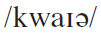
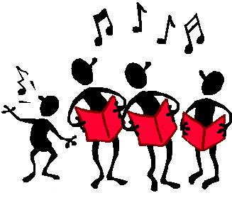
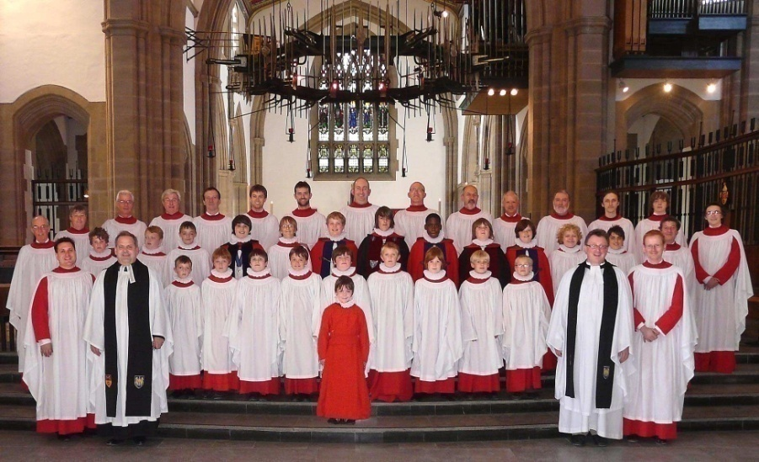
Words & Phrases
choir n. [C] a group of singers who perform together, for example in a church or school（学校的）合唱团；（教堂的）唱诗班
e.g.
1. The choir was singing distinctly out of tune in places.
合唱团有些地方明显唱走调了。
2. Robert sings in a church choir every Sunday.
罗伯特每个礼拜天在教堂唱诗班唱歌。

Slide 76
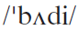
Words & Phrases
buddy n. [C] (AmE)(infml) a friend 朋友
e.g.
1. We are only Internet buddies.
我们只是网友。
2. Jack and Tom have been bosom buddies since they were kids.
杰克和汤姆从小就是情同手足的好兄弟/铁哥们。

Slide 77
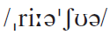
Words & Phrases
reassure vt. make sb. feel less worried about sth. 使放心；使安心
e.g.
1. The manager tried to reassure her that she would not lose her job.
经理试图让她放心，说她不会失业。
2. We went to the hospital to reassure ourselves about his condition.
我们去医院查明他的病情以使我们安心。
3. The salesman reassures me that the machine is safe to use.
销售员让我放心，这台机器是可以安全使用的。
Word family: reassurance n.

Slide 78
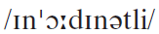
Words & Phrases
inordinately ad. much more than you would usually expect: used for emphasizing how large sth. is or how much of sth. there is 超乎想象地；极度地
e.g.
1. Actually he is inordinately fond of personal dictatorship, as if he would not look like a leader unless he were dictatorial.
他实际上十分爱好个人独裁，好象不独裁就不像一个领导者的样子。
2. Inordinately large doses in patients may cause death.
用药量过大会导致患者死亡。

Slide 79
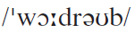
Words & Phrases
wardrobe n. [C] a large piece of furniture like a large cupboard where you can hang your clothes 衣柜；衣橱
e.g.
1. Can you hang these shirts in the wardrobe, please?
请你把这些衬衫挂到衣橱里去好吗？
2. The wardrobe takes up too much space/room.
这衣橱太占地方了。

Slide 80
Words & Phrases
check in:
1. arrive at a hotel or a private hospital where you have arranged to stay and give your personal details to the person working at the reception desk 登记住宿；登记住院
e.g.
1. We checked in at the reception desk and were then shown to our rooms.
我们在总台登记后便有人把我们引到房间。
2. He checked in last week and checked out early this morning.
他上星期入住/院，今天一早结账离开/出院。

Slide 81
Words & Phrases
2. arrive at an airport and show your ticket to an official （在机场）办理登机手续
e.g.
1. Unaccompanied baggage must be checked in at the airport in advance.
非随身携带的行李必须提前在机场办理托运手续。
2. We checked in and went straight to the departure lounge to wait for our flight to be called.
我们办理了登机手续之后，直奔离港候机大厅，等待我们航班 的通知。
check-in n.
e.g. check-in desk (BrE) / check-in counter (AmE)
(机场)办理登机手续处

Slide 82
Words & Phrases
out of order: a machine or piece of equipment that is out of order is not working correctly （机器或设备）出故障的，运作不正常的
e.g.
1. My computer was out of order again yesterday.
我的电脑昨天又出问题了。
2. He came to the conclusion that the machine was out of order.
他断定机器出毛病了。
3. The washing machine has been out of order for weeks and nobody has it repaired.
洗衣机已经坏了好几周了，没有人报修。

Slide 83
Words & Phrases
stretch out: lie down, usually in order to relax or sleep 躺下（放松或睡觉）
e.g.
1. After a long day’s work, she likes to stretch out on her bed to rest after a hot bath.
在经历了一天漫长的工作后，她喜欢在洗完热水澡后躺在床上休息。
2. Whenever confronted with a task which seemed too hard to be dealt with, he would stretch out on his laboratory sofa and let fantasies flood his mind.
无论何时他遇到一个好像解决不了的问题时，他会躺在实验室 的沙发上，四肢舒展，让各种幻觉涌满他的脑海。
See also: stretch

Slide 84
Words & Phrases
go along:
1. travel somewhere with sb. else 和（某人）一起去
2. continue to happen or develop 继续；进展
3. agree with sb. / sth. 同意
Work in pairs. Figure out the meanings of the phrase. Match its usage with the meaning 1, 2 or 3 .
1. His wife will go along with him to his new post. ( )
2. The book gets more difficult as you go along. ( )
3. I don’t think he’ll go along with you on the plan. ( )
1
2
3

Slide 85
Words & Phrases
sign up for: agree to do sth. or to join a course or organization 同意从事；报名参加
e.g.
1. The famous film star has signed up for a new film production.
那位著名影星已签约参加拍摄一部新片。
2. Can I sign up for this course in advance?
我能先报名上这门课吗？
See also: sign

Slide 86
Words & Phrases
rent out: allow a house, room, office etc that you own to be used by sb. who pays you regularly for using it 出租（房屋，办公室等）
e.g.
1. They had to rent out the upstairs to make mortgage payments.
他们不得不将二楼租出去来付房屋的抵押借款。
2. She decided to rent out a room to get extra income.
她决定出租一个房间来增加收入。

Slide 87
Words & Phrases
Cf. hire let lease rent 租；租赁
hire:
指出钱获得他人的劳动或服务，也指雇佣他人或出租某物
let:
指同意他人暂时占有并使用自己的土地、房屋或财产，以收取规定的租金
lease:
表示根据书面契约租出或租用，尤指房地产
rent:
指双方协定以交纳租金的方式临时租借土地、房屋等财产

Slide 88
Words & Phrases
hire let lease rent
Fill in the blanks with proper words.
The company _______ its cars from a local supplier.
Will you ___________ a car when you are in Spain?
Most students ______ rooms in their second year.
He used to ______ out horses and carriages by the day.
lease
hire/rent
rent
let

Slide 89
Words & Phrases
as long as: used before saying the conditions that will make sth. else happen or be true 只要
e.g.
1. As long as we are united, there is no difficulty we cannot overcome.
只要我们团结一致, 就没有克服不了的困难。
2. You can stay as long as you pay the rent on time.
只要你按时交房租，你就能住在这儿。
3. My parents don’t care what college I go to as long as I’m happy.
我父母不在乎我上什么大学， 只要我高兴就行。

Slide 90
Words & Phrases
burst into tears / song / laughter：suddenly start crying / singing / laughing 突然哭 / 唱 / 笑起来
e.g.
1. As soon as she saw me, she burst into tears.
她一见到我就哭了起来。
2. When the children saw their teacher, they burst into laughter.
孩子们一见到老师就大笑起来。
3. Can you tell me why they burst into song?
你能不能告诉我他们为什么突然唱起歌来？

Slide 91
Words & Phrases
run out of: use all of sth. and not have any left 用光；耗尽
e.g.
1. The library is about to run out of shelf-space.
这家图书馆的书架快摆满书了。
2. We’re running out of time. / Our time is running out.
我们时间来不及了。
3. I ran out of money every month at time. I could not save a single penny.
那个时候我每个月钱都用光,一分钱都没办法存下来。
4. People seldom realize the seriousness of the problem until they have run out of resources.
人们很少意识到问题的严重性，直到他们把资源都耗尽了。

Slide 92
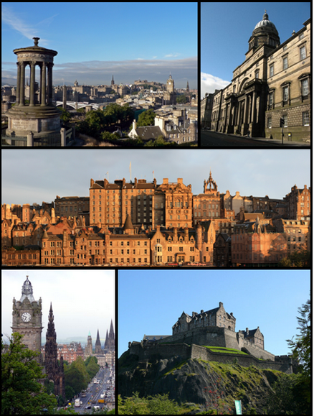
Words & Phrases
Edinburgh
爱丁堡（苏格兰首府）
Edinburgh is the capital city of Scotland. It is the second most populous city in Scotland and the seventh most populous in the United Kingdom. It is the second largest financial centre in the UK after London. The city’s historical and cultural attractions have made it the second most popular tourist destination in the United Kingdom after London, attracting over one million overseas visitors each year.

Slide 93
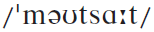
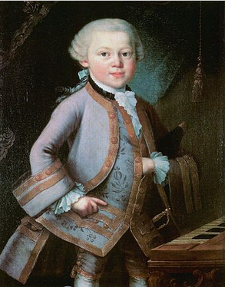
Words & Phrases
Mozart 莫扎特
（1756-1791，奥地利作曲家、维也纳古典乐派主要代表）
Mozart, born in Salzburg (a city in Austria), was a prolific and influential composer of the Classical era. Mozart showed prodigious ability from his earliest childhood. He was competent on keyboard and violin by age five, and he composed from the age of five and performed before European royalty.

Slide 94
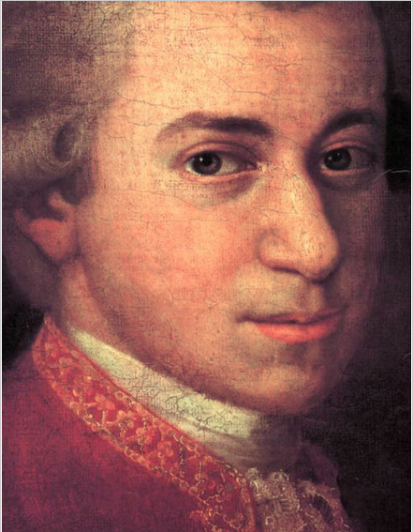
Words & Phrases
At 17, Mozart was engaged as a musician at the Salzburg court, but grew restless and traveled in search of a better position. While visiting Vienna in 1781, he was dismissed from his Salzburg position. He chose to stay in the capital, where he achieved fame but little financial security. During his final years in Vienna, he composed many of his best-known symphonies, concertos, and operas, and portions of the Requiem, which was largely unfinished at the time of his death.

Slide 95

Words & Phrases
The circumstances of his early death have been much mythologized. He was survived by his wife Constanze and two sons. He composed more than 600 works, many acknowledged as pinnacles of symphonic, concertante, chamber, operatic, and choral music. He is among the most enduringly popular of classical composers, and his influence is profound on subsequent Western art music.

Slide 96


Language Points
My room is five floors up, and the lift has a sign on it, "Out of order".
My room is on the fifth floor. But there is a sign on the lift, saying that the lift is not working. (So the writer and her parents have to climb up to the fifth floor. That is why the writer says her mother is flushed and gasping for breath in the next sentence.)
翻译：
我的房间在6楼，可电梯上写着“电梯已坏”。

Slide 97
Language Points
Finally, with my mother flushed and gasping for breath, we find Room 8 …
with sb. doing sth. 结构通常表示与句子主语动作相伴随的动作或状况。
e.g. With my friend dancing, I sang the song I wrote.
在朋友的伴舞下，我唱起了自创的歌曲。
翻译：
等我们终于找到8号房间的时候，妈妈已经涨红了脸，累得上气不接下气……

Slide 98
Language Points
After one minute, my father climbs out.
climb out: The writer uses the expression climbs out to indicate that the room is too small. It is so small that one needs to “climb in and out” instead of “walk in and out”. Here the writer is exaggerating, as she does in some of the coming paragraphs.
翻译：
但爸爸马上就从里面爬了出来。

Slide 99
Language Points
The room is barely big enough for one … I can stretch out full-length on the bed and touch three walls without moving a muscle.
The room is too small. When I lie on the bed, I can touch three walls even when I am not moving my body. In the two sentences the writer is using exaggeration to say how small the room is.
翻译：
这个房间刚刚够一个人住……我躺在床上，把全身伸直，不动弹就可以碰到三面墙。

Slide 100
Language Points
Later.
Usually “later” is not used as a sentence. But in writing a diary the writer may write casually, not rigidly following grammatical rules.
翻译：
后来。

Slide 101
Language Points
5 There’s a coffee morning for first-year students. I meet my tutor, a lofty man with sloping shoulders, who looks determined to be affable.
6 “Have you come far?” He peers down at me. As he speaks, his head jerks wildly from side to side, which makes his coffee spill into the saucer.
In these two paragraphs, the writer gives a vivid physical description of her tutor who is uncomfortable in the situation and doesn’t know how to act. He’s trying to be relaxed and friendly, but it doesn’t come naturally to him, and he doesn’t manage to establish a good relationship with the students.

Slide 102
Language Points
5 There’s a coffee morning for first-year students. I meet my tutor, a lofty man with sloping shoulders, who looks determined to be affable.
6 “Have you come far?” He peers down at me. As he speaks, his head jerks wildly from side to side, which makes his coffee spill into the saucer.
A coffee morning refers to an informal gathering with coffee, where people with a common interest meet for an hour or so and get to know each other better. In this case it’s for the new students, but it might be for residents in a neighbourhood or for new neighbours.
翻译：
……咖啡早茶会……

Slide 103
Language Points
5 There’s a coffee morning for first-year students. I meet my tutor, a lofty man with sloping shoulders, who looks determined to be affable.
6 “Have you come far?” He peers down at me. As he speaks, his head jerks wildly from side to side, which makes his coffee spill into the saucer.
A tutor in the UK is a teacher or lecturer who has particular responsibility for a small group of students (a personal tutor who sees particular tutees). A tutorial is a period of teaching in a university which emphasizes critical discussion between one student, or a small group, and a tutor. Generally this is on a prepared topic, and sometimes students bring prepared writing (notes or a draft essay) and make a presentation to the tutor and other students, which is then discussed.

Slide 104
Language Points
“Splendid!” he says, and moves on to the freshman standing beside me. “Have you come far?” he asks. “Splendid,” he barks, without waiting for the answer, and moves on.
The tutor asks the same question and gives the same response to students’ answers. He moves on to the next student without even waiting to hear the previous student’s answer. This indicates that the tutor is not really interested in talking to the students. Also note that the writer uses the word barks to indicate how unpleasant the tutor is in his way of speaking.
翻译：
“好极了！”他说，接着又转向站在我旁边的那个新生。“你是从很远的地方来的吗？”他问。但不等那人作出任何回答，他就喊道，“好极了！”然后就继续询问他人。

Slide 105
Language Points
“Splendid!” he says, and moves on to the freshman standing beside me. “Have you come far?” he asks. “Splendid,” he barks, without waiting for the answer, and moves on.
为了避免性别歧视，英语中由 -man 之类的词衍生出了一些中性的词语，如chairperson ( 对应chairman 与chairwoman )，spokesperson ( 对应 spokesman 与 spokeswoman )，businessperson (对应 businessman 与businesswoman) 等。

Slide 106
Language Points
He takes a sip of coffee, and looks thunderstruck to discover the cup is empty.
The expression looks thunderstruck further reinforces the unpleasant image of the tutor. Of course, the writer is exaggerating in using the word thunderstruck.
翻译：
他啜了一口咖啡，却惊讶地发现杯子是空的。

Slide 107
Language Points
Am feeling a bit peckish, and it occurs to me that …
这句话在语法上不是一个完整的句子。主语“I”省略了。写日记时，作者可以采用自由随意的风格。而在正式文体中，则应避免这种自由随意的风格。
occur to: if a thought or idea occurs to you, you suddenly and unexpectedly start to think about it （想法或主意）被想到，被想起
常被用在It occurs to sb. that … 句型中
e.g.
1. The thought of giving up never occurred to me.
我从未想过要放弃。
2. It had never occurred to him that he might be falling in love with her.
他从未想到自己会爱上她。
翻译：
我觉得有点儿饿，这才意识到……

Slide 108
Language Points
The boy in front piles it all onto his plate ...
This is not the usual amount of food that one eats at a meal. The writer is using exaggeration.
翻译：
前面的男生每样儿都取了一些放到托盘上……

Slide 109
Language Points
I pull on some clothes, and dash over to the lecture hall.
The expression pull on some clothes indicates that the writer puts on her clothes in a hurry because she was afraid that she might be late for class.
翻译：
我穿好衣服，急匆匆地跑到大讲堂。

Slide 110
Language Points
The lecture takes an hour, and at the end I look at my notes. I can’t read my handwriting.
From this we know how absent-minded the writer is in the class.
翻译：
讲座持续了1个小时。结束时我看了看笔记，我根本就看不清我写了些什么。

Slide 111
Language Points
… an English literature major …
An English literature major is a degree in English or a student reading English, perhaps with a subsidiary subject. In American usage, the main subject of study or specialization for a degree is often combined with a less-studied subject (a minor).
翻译：
……英语文学专业的学生……

Slide 112
Language Points
She’s a bit impressive, and I feel so ignorant … I don’t even think I should breathe the same air as her.
This sentence is exaggerated and humorous, emphasizing the gap between the writer and Sophie — Sophie seems much more intelligent, knowledgeable and enthusiastic than the writer. In comparison, the writer feels so ignorant that she thinks she doesn’t deserve to breathe the same air as Sophie.
翻译：
她令人钦佩，我觉得自己太无知了……我甚至不配跟她呼吸同样的空气。

Slide 113
Language Points
Freshers’ Fair
A Freshers’ Fair is largely arranged by university faculties, student societies and clubs to give information to new students in their first week at university, and to attract new members. Often faculties, departments, societies and clubs will set up a table or tent on campus where they display the information about the faculty, society or club, and about how they are able to help students. They give out information packs to students. Sometimes they also give students small gifts or discount vouchers for nearby restaurants, pubs or shops. For new students in the UK, there is usually an induction week when they receive a lot of information about their courses.
翻译：
新生集会

Slide 114
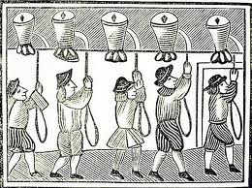
Language Points
bell-ringing
Bell-ringing is a musical activity which involves a group of six to ten people. Each person has two bells, one in each hand, and takes turns to ring them. Each bell has a different musical note, so when the bells are rung in turn, the group can make musical melodies and harmonies. Traditionally, church bells were rung to tell people nearby that a church service was about to begin.
翻译：
手铃

Slide 115


Language Points
bell ringing

Slide 116
Language Points
For some reason, I also have to swear that I won’t damage the books or break the library rules, and if I do, I’ll be sent to prison.
Again, this is humour through exaggeration. All libraries have rules, but those who break the rules are unlikely to go to prison. The expression for some reason indicates that the writer doesn’t understand why she needs to swear to follow the library rules.
swear: vt. make a promise to do sth. 发誓，许诺（要做某事）
e.g. He swore that he would never see her again.
他发誓再也不会和她见面。
翻译：
出于某种原因，我还得发誓不会损坏书籍、不会违反图书馆的规定，否则我就要进监狱。

Slide 117
Language Points
(What!? For speaking too loudly?)
The sentence is in brackets. This is what the writer thinks to herself. She does not say it out loud.
翻译：
什么！？ 就因为大声说话吗？

Slide 118
Language Points
I’m not sure what happens to my dirty clothes after putting them in the clothes basket and before finding them clean, ironed and folded in my wardrobe.
This is a humorous reference to the fact that at home, her mother does all of her washing. Hence she claims not to know what happens to her clothes, as she is not involved in cleaning them.
翻译：
我可不清楚把脏衣服扔进脏衣篮之后到它们干干净净、熨烫笔挺并叠好放进衣柜之前都发生了什么。

Slide 119

Exercises
Reading and understanding
Dealing with unfamiliar words
Reading and interpreting
Developing critical thinking

Slide 120
Exercises
Reading and understanding
2 Check (√) the true statements.
3 Choose the best way to complete the sentences.

Slide 121
Exercises
2 Check (✔) the true statements.
⃝ 1 It’s a description of the first few days at college.
⃝ 2 It’s a personal and private story.
⃝ 3 The writer uses past tenses.
⃝ 4 It’s factual.
⃝ 5 It’s written in the third person.
√
√
√

Slide 122
Exercises
3 Choose the best way to complete the sentences.
1 The writer is staying in ______.
(a) university accommodation
(b) a flat
(c) a small study
(d) a hotel
2 When meeting the new students, the tutor ______.
(a) finds it easy to relax with them
(b) seems very friendly
(c) welcomes them warmly to the university
(d) doesn’t seem to find the students interesting

Slide 123
Exercises
3 When the writer finally gets to the lecture hall, ______.
(a) she meets Sophie, whom she already knows
(b) Sophie is giving a lecture
(c) she’s too late and isn’t allowed in
(d) she attends the first lecture of her university course
4 At the Freshers’ Fair students can choose to join ______.
(a) music and drama clubs
(b) sports clubs
(c) the same clubs as their friends
(d) all kinds of clubs for all interests

Slide 124
Exercises
5 When the writer goes to the university library, she finds out that it ______.
(a) has very strict rules
(b) doesn’t allow people to use the books
(c) is new
(d) contains only a few books
6 At the end of her first week, the writer ______.
(a) is missing her mother
(b) is enjoying herself enormously
(c) has done all her washing
(d) wants to finish her assignments

Slide 125
Exercises
Dealing with unfamiliar words
When we come across a new word, we can try to work out its general meaning by thinking about:
• what part of speech it is
• if you already know one of its meanings
• if there are clues to its meaning in the immediate context or elsewhere in the passage
For some new words, we should not only learn about their meanings, but also how to use them. For some others, we may not need to know what they exactly mean, or how to use them.

Slide 126
Exercises
4 Replace the underlined words with the correct form of the words below.
5 Complete the sentences with the correct form of the expressions below.
6 Answer the questions about the words.

Slide 127
Exercises
4 Replace the underlined words with the correct form of the words below.
barely ignorant impressive intelligent
peer sip spill
1 There was only just enough room for two people.
2 Be careful or you’ll accidentally pour your drink down your clothes.
3 He was completely unaware of what to do in the library.
4 She was very clever and got excellent grades.
5 The tea is very hot! Drink it in small amounts.
6 She was short-sighted, so she looked at you as if she didn’t recognize you.
7 In my opinion, his academic work and his skill in sport are extremely good.
barely
spill
ignorant
intelligent
Sip
peered
impressive

Slide 128
Exercises
5 Complete the sentences with the correct form of the expressions below.
check in rent out run out of
stretch out stumble across
1 We were taking a walk in the countryside when we ______________ a lovely pub which we didn’t know about.
2 If you buy a large house, you can _________some of the bedrooms to students.
3 It was a very large bed, so I lay down and ____________.
4 I’d love something to drink, but we’ve _________ coffee, so I’ll have to go and buy some.
5 We got to the airport, __________ and then went through passport control.
stumbled across
rent out
stretched out
run out of
checked in

Slide 129
Exercises
6 Answer the questions about the words.
1 Is a wearisome journey likely to be (a) enjoyable and interesting, or (b) tiring and dull?
2 Is a warden likely to be (a) a teacher at the college, or (b) someone who looks after the hall of residence?
3 Is someone who is lofty likely to be (a) tall, or (b) short?
4 Is an affable man likely to be (a) pleasant and friendly, or (b) rude and unkind?
5 If someone jerks their head, is it likely to be a (a) gentle, or (b) sudden movement?
6 Is someone who is thunderstruck likely to be (a) very surprised or shocked, or (b) cheerful and relaxed?
7 If you’re peckish, are you likely to be (a) a little hungry, or (b) a little thirsty?
8 Is your buddy likely to be your (a) friend, or (b) enemy?
6 Answer the questions about the words.
1 Is a wearisome journey likely to be (a) enjoyable and interesting, or (b) tiring and dull?
2 Is a warden likely to be (a) a teacher at the college, or (b) someone who looks after the hall of residence?
3 Is someone who is lofty likely to be (a) tall, or (b) short?
4 Is an affable man likely to be (a) pleasant and friendly, or (b) rude and unkind?
5 If someone jerks their head, is it likely to be a (a) gentle, or (b) sudden movement?
6 Is someone who is thunderstruck likely to be (a) very surprised or shocked, or (b) cheerful and relaxed?
7 If you’re peckish, are you likely to be (a) a little hungry, or (b) a little thirsty?
8 Is your buddy likely to be your (a) friend, or (b) enemy?

Slide 130
Exercises
Reading and interpreting
7 Work in pairs. Look at the sentences from the passage and answer the questions.
1 As he speaks, his head jerks wildly from side to side, which makes his coffee spill into the saucer.
What impression do you have of the tutor?
2 “Splendid,” he barks, without waiting for the answer, and moves on.
Is the tutor really interested in the students he’s talking to?
3 … today’s menu includes chicken, rice, potatoes, salad, vegetables, cheese, yoghurt and fruit. The boy in front piles it all onto his plate, pays for it, and goes to sit down.
Is this a usual amount of food to eat at one meal?
4 … and I feel so ignorant … I don’t even think I should breathe the same air as her.
What does the writer think of Sophie?

Slide 131
Exercises
7 Work in pairs. Look at the sentences from the passage and answer the questions.
1 As he speaks, his head jerks wildly from side to side, which makes his coffee spill into the saucer.
What impression do you have of the tutor?
I have the impression that the tutor is trying to appear friendly and interested, though he actually has no interest in the students.

Slide 132
Exercises
2 “Splendid,” he barks, without waiting for the answer, and moves on.
Is the tutor really interested in the students he’s talking to?
No, it seems not. His answer of “Splendid” does not match his action.

Slide 133
Exercises
3 … today’s menu includes chicken, rice, potatoes, salad, vegetables, cheese, yoghurt and fruit. The boy in front piles it all onto his plate, pays for it, and goes to sit down.
Is this a usual amount of food to eat at one meal?
No, the boy is either very hungry or greedy, and this is exaggerated behaviour.

Slide 134
Exercises
4 … and I feel so ignorant … I don’t even think I should breathe the same air as her.
What does the writer think of Sophie?
The writer thinks that Sophie is superior and very academic (intelligent / hard-working). The comment about breathing the same air is exaggeration.

Slide 135
Exercises
Developing critical thinking
8 Work in pairs and discuss the questions.
1 Which aspects of the writer’s account of her first day at university do you find interesting?
2 Which aspects of the writer’s university could be introduced successfully into Chinese universities?
3 What improvements would you like to make in the first days for freshers at Chinese universities?

Slide 136
Exercises
1 Which aspects of the writer’s account of her first day at university do you find interesting?
I find it interesting how little the writer seems to know about how life would be at university — she is shocked by the size of her room and doesn’t know when meals are. I like the way that the writer uses humour to disguise the homesickness and worry that she clearly feels.

Slide 137
Exercises
2 Which aspects of the writer’s university could be introduced successfully into Chinese universities?
As a Chinese student, I find the coffee morning and Club Night very interesting. They could be introduced to Chinese universities. The coffee morning would allow students to get to know their tutors in an informal and enjoyable environment. The Club Night would provide a great opportunity for students to make more friends!

Slide 138
Exercises
3 What improvements would you like to make in the first days for freshers at Chinese universities?
I would like to introduce orientation week to Chinese universities. I think orientation week would make freshers at Chinese universities more comfortable in their first days at school. During orientation week, freshers can get familiar with the campus, the student clubs, and their fellow schoolmates through a series of activities and lectures that the university holds.

Slide 139

Extension Activities
Blog
What’s a blog?
A blog is your best bet for a voice among the online crowd. It’s a personal website, jam-packed with features, as easy to use as your email.

Slide 140

Extension Activities
blog & blogger
The word “blog” comes from “web + log”, and “blogger” means the person who writes blogs.

Slide 141

Extension Activities
Many blogs provide commentary or
news on a particular subject; others
function as more personal online
diaries. A typical blog combines text,
images, and links to other blogs, Web
pages, and other media related to its
topic. The ability of readers to leave
comments in an interactive format is an
important part of many blogs.

Slide 142

Extension Activities
Most blogs are primarily textual, although some focus on art (art blog), photographs (photoblog), videos (video blogging), music (MP3 blog), and audio (podcasting). Microblogging is another type of blogging, featuring very short posts.

Slide 143
Extension Activities
Type
There are many different types of blogs, differing
not only in the type of content, but also in the way
that content is delivered or written.
1. Personal blogs (i.e. Yang Lan’ Blog)
2. Corporate and organizational blogs
(i.e. The White House Blog)

Slide 144

Extension Activities
By genre
political blogs / travel blogs (also known
as travelogs) / house blogs / fashion blogs / project
blogs / education blogs / niche blogs / classical
music blogs / quizzing blogs and law blogs(often referred to
as blawgs) or dreamlogs / art blogs / music blogs

Slide 145


Extension Activities
A blog featuring discussions
especially about home and family
is not uncommonly called a mom
blog.
While not a legitimate type of blog, one used for the
sole purpose of spamming is known as a Splog.

Slide 146


Extension Activities
More:
A microblog differs from a traditional blog in that its content is typically much smaller, in both actual size and aggregate file size ( at most 140 words ). A microblog entry could consist of nothing but a short sentence fragment, an image or a embedded video.

Slide 147

Extension Activities
By media type
vlog (a blog comprising videos);
linklog (one comprising links);
sketchblog (a site containing a portfolio of sketches);
photoblog (one comprising photos);
tumblelogs (with shorter posts and mixed media types);
typecasting (blogging) ( written on typewriters and then scanned are called typecast or typecast blogs

Slide 148

Extension Activities
By device
Moblog (written by a mobile device like a mobile phone or PDA)

Slide 149

Extension Activities
By device
Sousveillance (One early blog was Wearable Wireless Webcam, an online shared diary of a person’s personal life combining text, video, and pictures transmitted live from a wearable computer and EyeTap device to a web site. This practice of semi-automated blogging with live video together with text was referred to as sousveillance. Such journals have been used as evidence in legal matters.
This wearable wireless webcam captures a recording of the wearer's personal experience whenever he desires.

Slide 150


Extension Activities
2. How to become a blogger?

Slide 151
Extension Activities
Get the top-level blog domain
Get your address at the best possible Internet real estate. You’ll get an address that looks like you.blog.com. It’s the virtual equivalent of your own island in Dubai, mansion in Monte Carlo or a Manhattan flat overlooking Central Park.

Slide 152


Extension Activities
Now, write a blog telling us what is your opinion about blog.

Slide 153

Extension Activities
Congratulations! You are a blogger, now!

Slide 154


Thank you

